Slide 1
Stock market charting screen flow

Slide 2
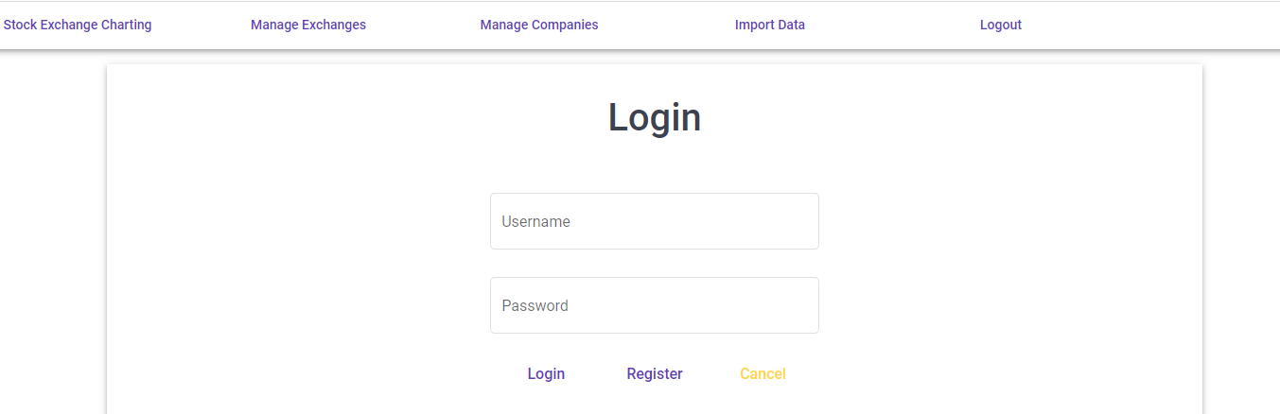
Login and menu
Login and menu
List and add stock exchanges
List, add, update company and update IPO related data
Import stock price

Slide 3
Admin functions

Slide 4
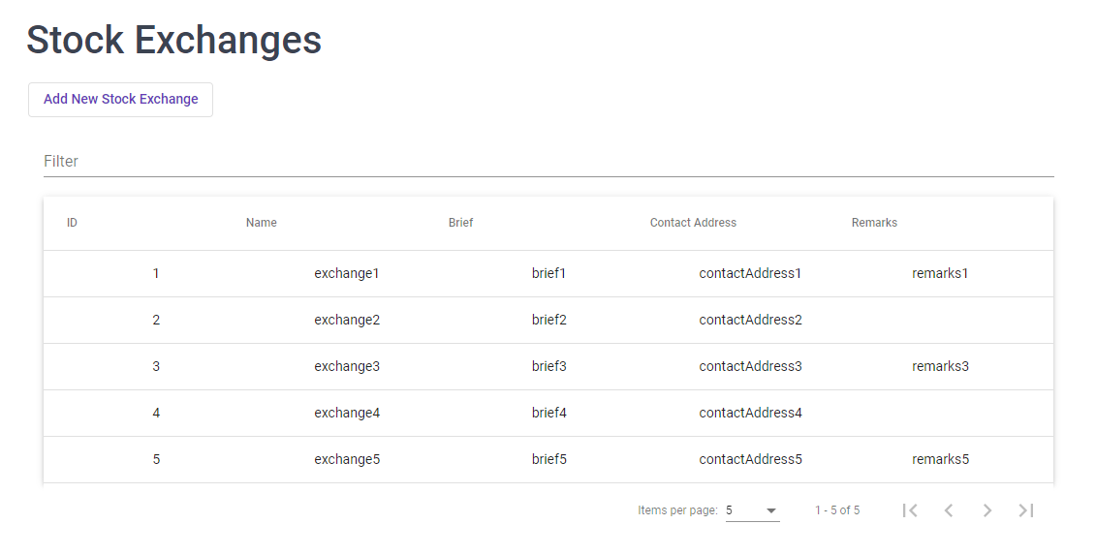
List Exchanges

Slide 5
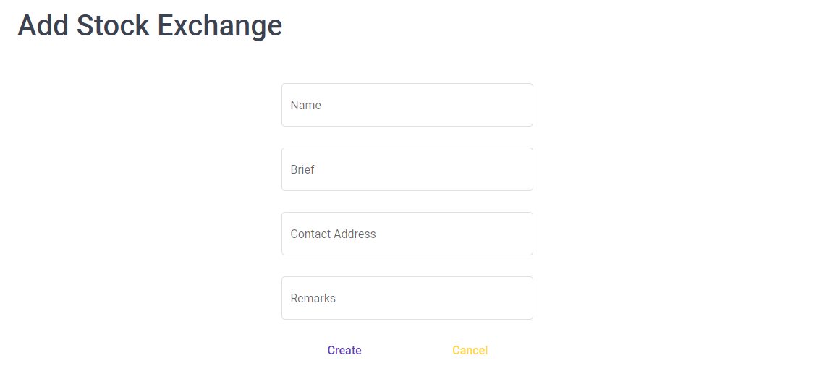
Add exchange
Add exchange

Slide 6
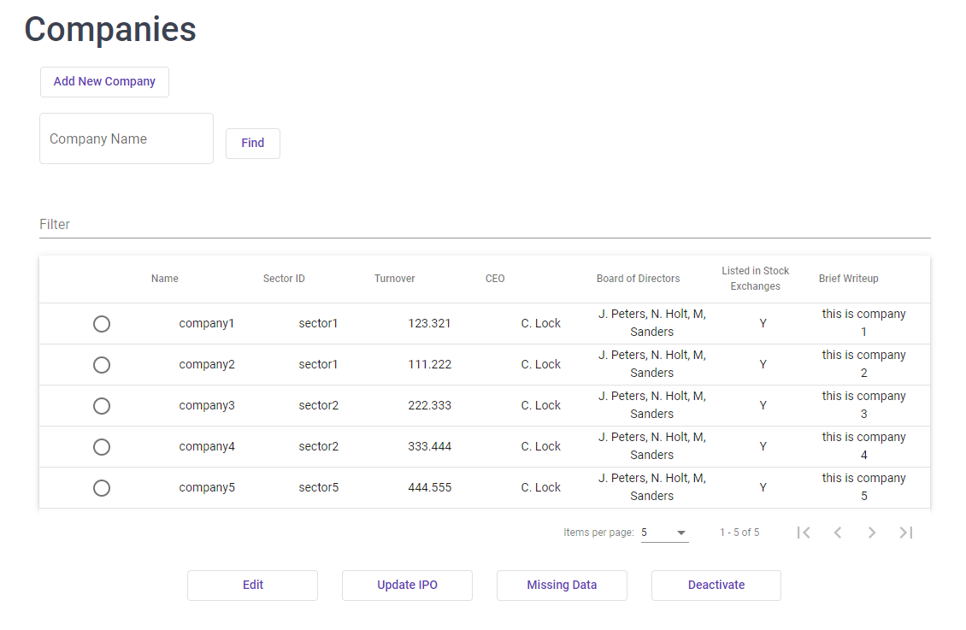
List companies
Add exchange

Slide 7
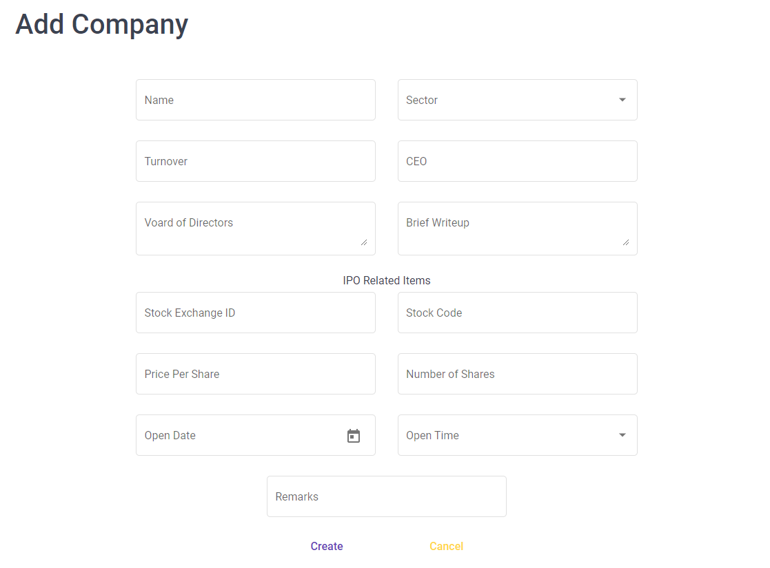
Add company
Add exchange

Slide 8
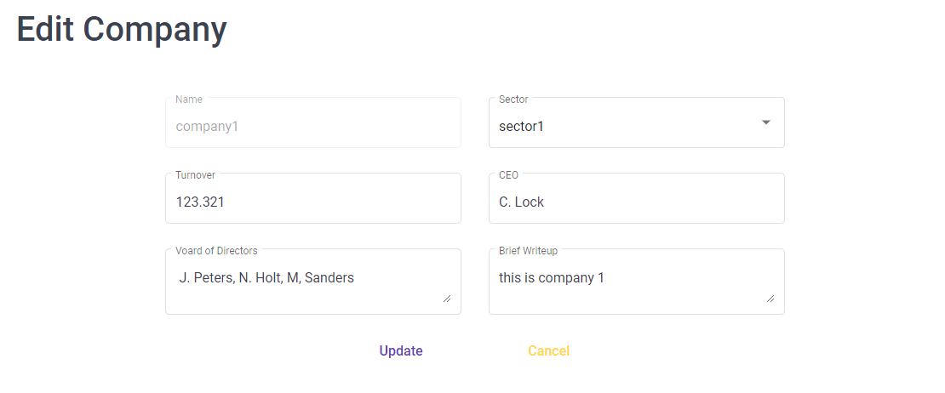
Edit company
Add exchange

Slide 9
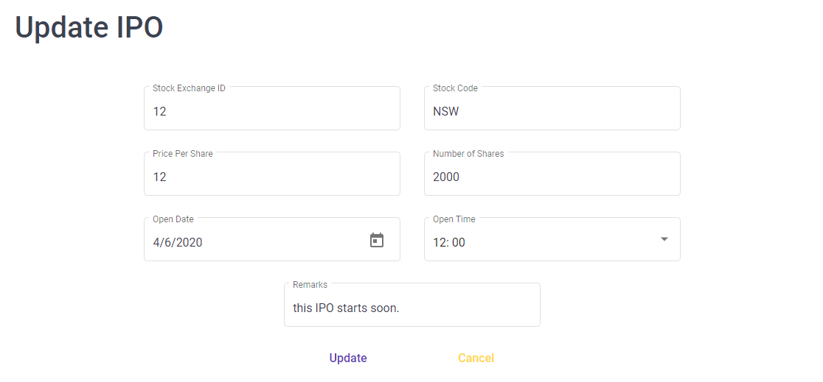
Update ipos
Add exchange

Slide 10
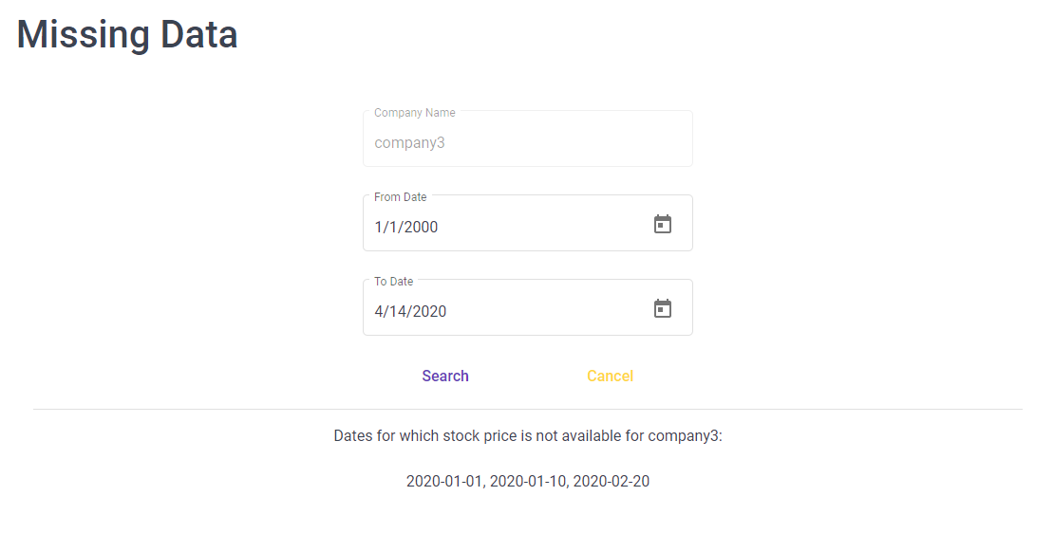
Missing data
Add exchange

Slide 11
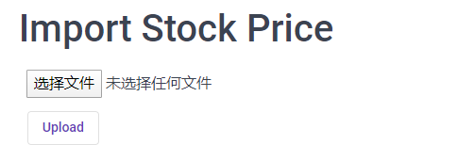
Import price
Add exchange

Slide 12

Import summary
Add exchange

Slide 13
Investor functions

Slide 14
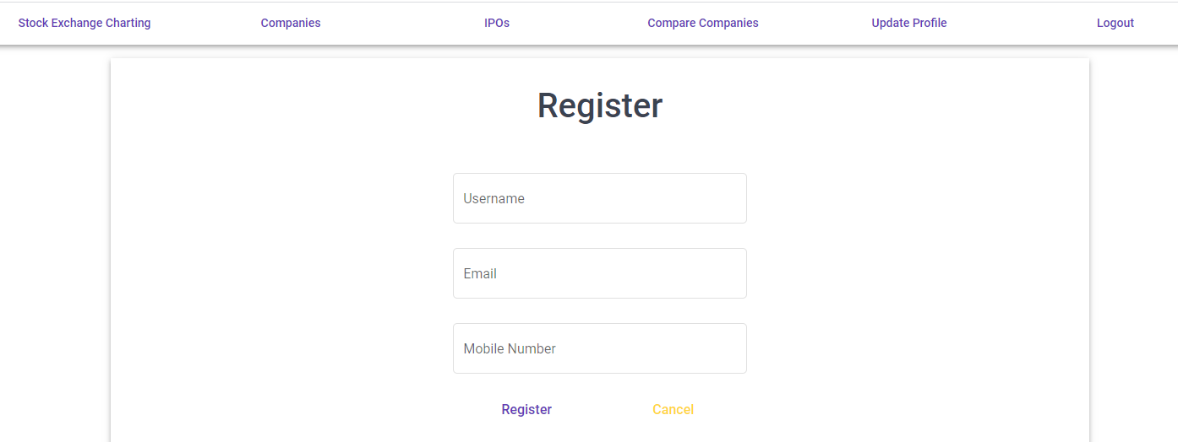
register
Add exchange
Search companies
View planed IPOs
Compare companies, display with charts

Slide 15
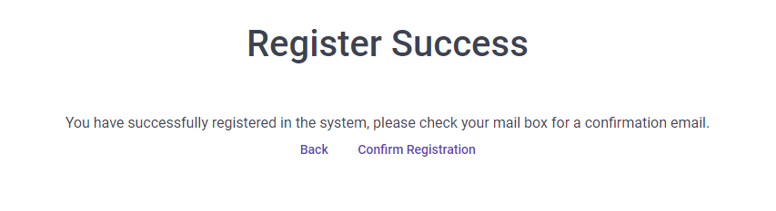
Register success
Add exchange

Slide 16
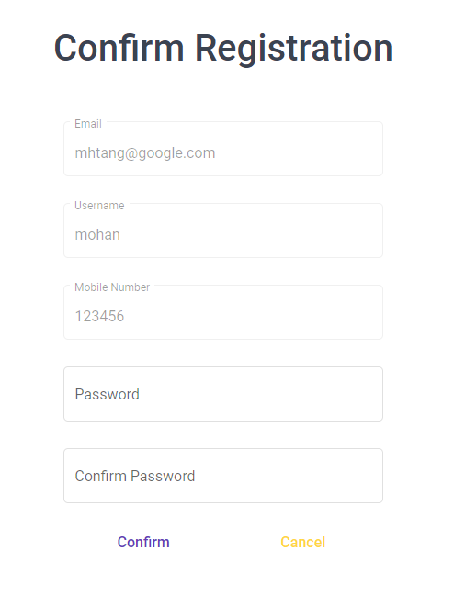
Confirm registration
Add exchange

Slide 17
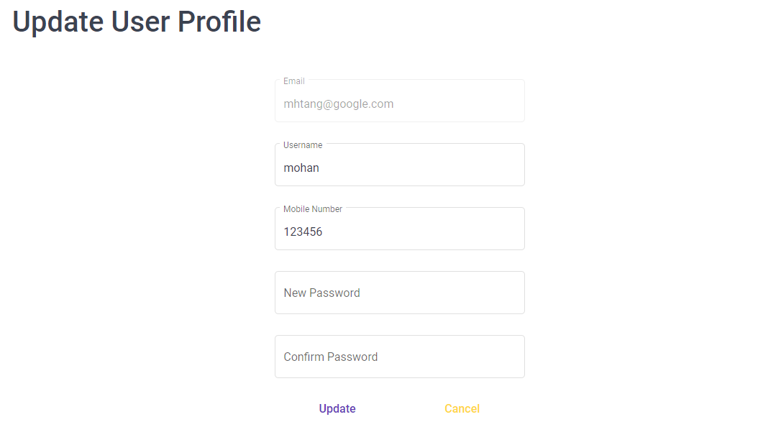
Update user profile
Add exchange

Slide 18
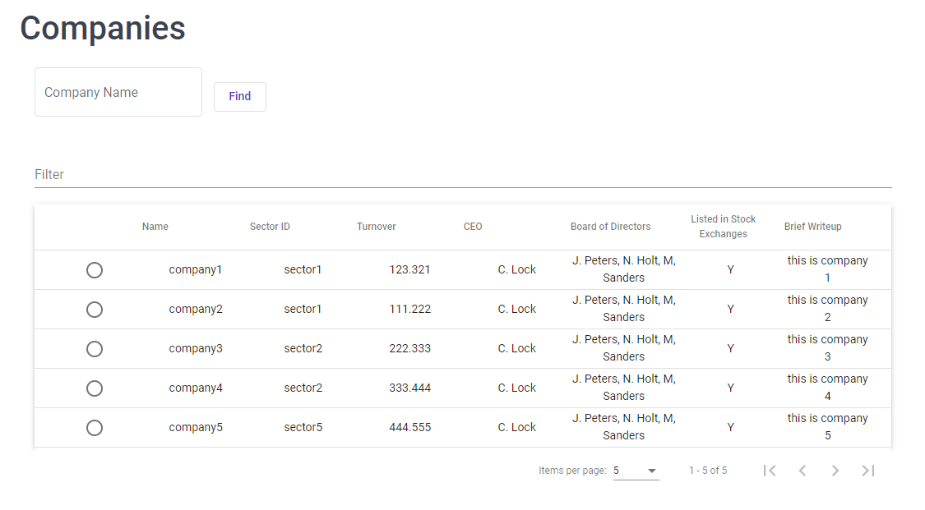
Search company
Add exchange

Slide 19
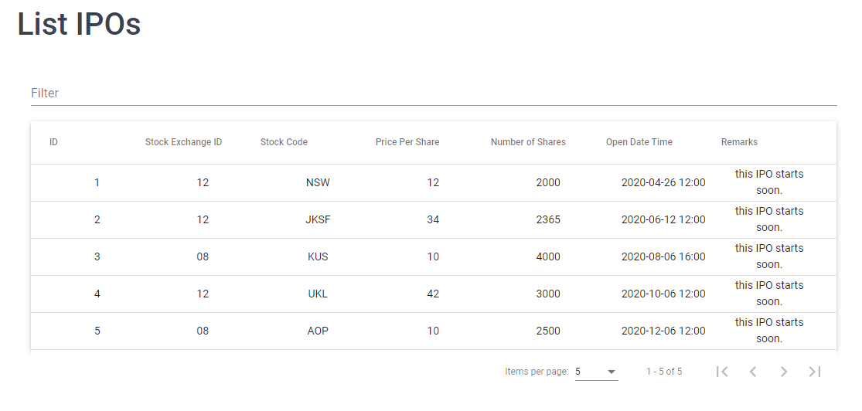
List ipo
Add exchange

Slide 20
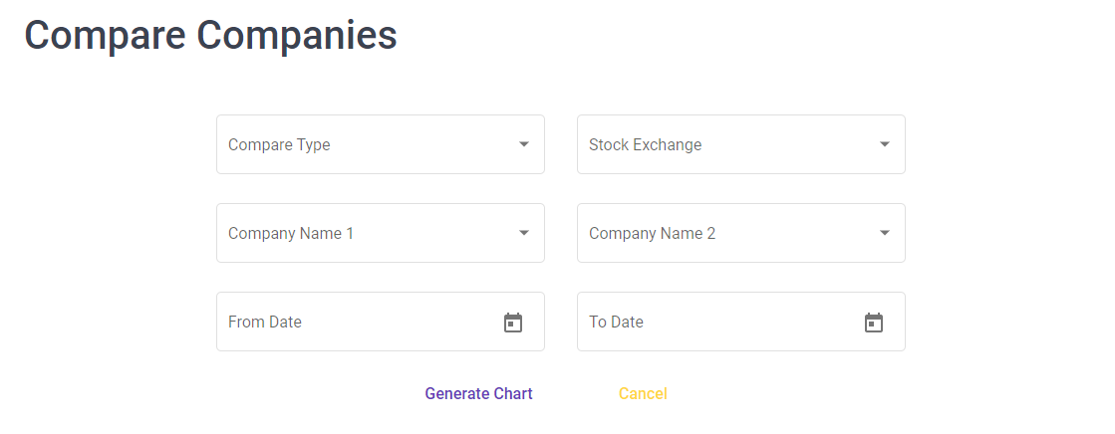
Compare companies
Add exchange

Slide 21
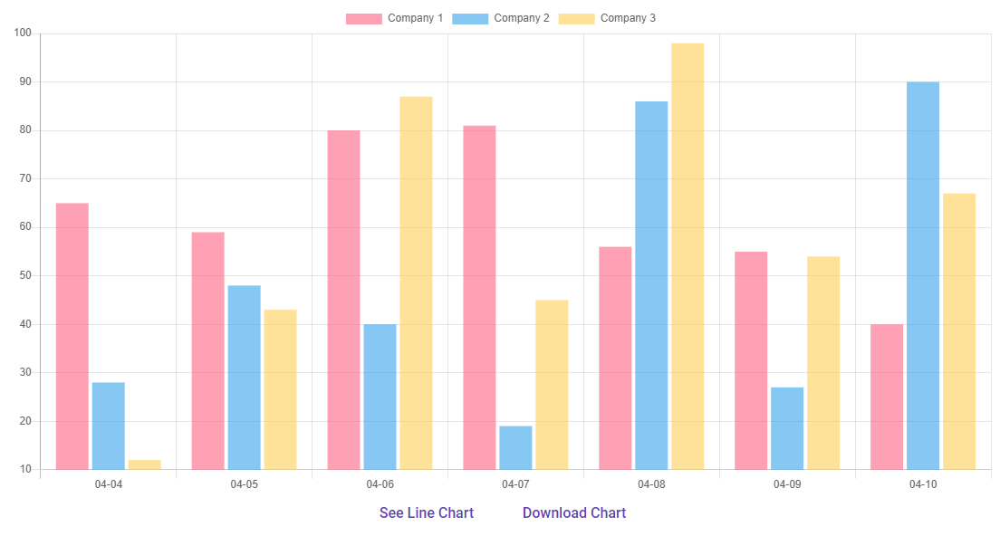
Compare bar chart
Add exchange

Slide 22
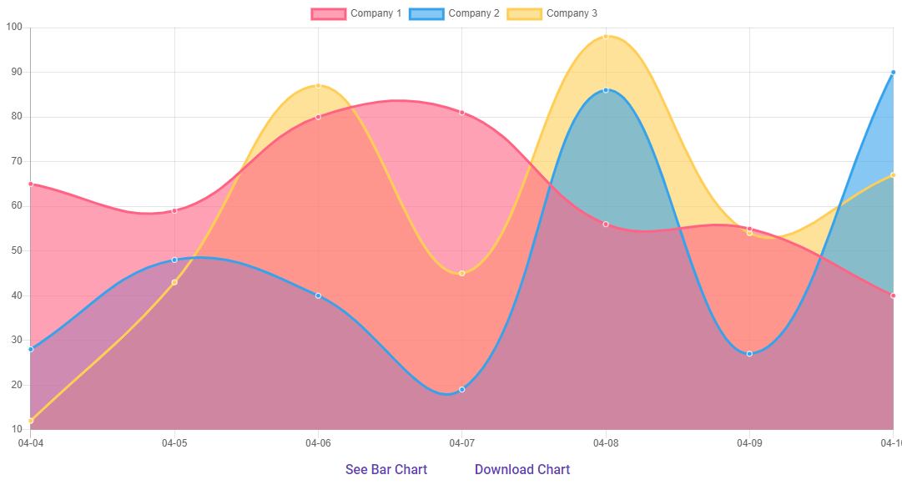
Compare line chart
Add exchange

Slide 23
thanks

